Slide 1
Randomized Algorithms CS648
Lecture 1
An overview of the course

Slide 2
Deterministic Algorithm
Input
Output
Algorithm
The output as well as the running time are functions only of the input.
Notes:
The output as well as the running time are functions only of the input.

Slide 3


Slide 4
Example 1 : Approximate median

Slide 5

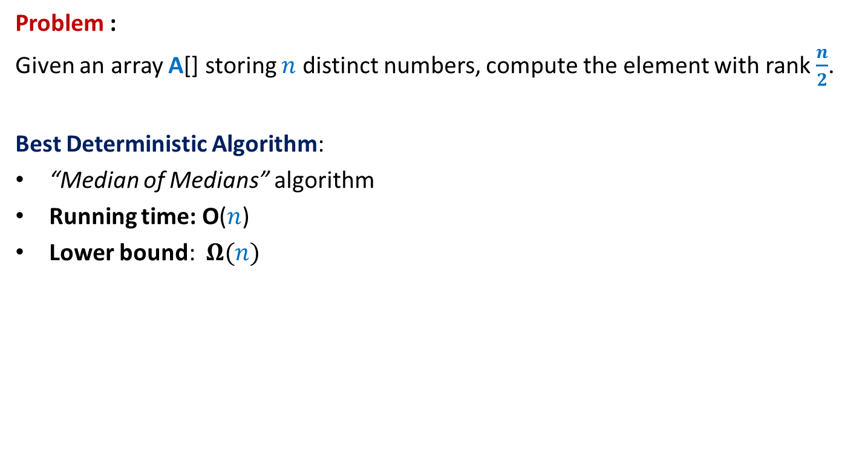
Approximate Median
Problem :
Given an array A[] storing $n$ distinct numbers, compute the element with rank $\frac{n}{2}$.
Best Deterministic Algorithm:
“Median of Medians” algorithm
Running time: O($n$)
Lower bound: $Ω(n)$
Reason: Every element must be read. Otherwise, …
A$[1..n]$
The unread element could be the median element.

Slide 6
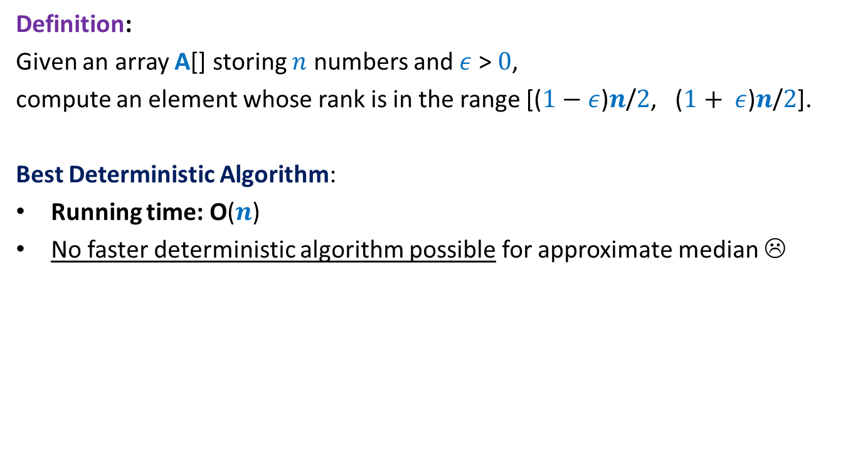

Approximate Median
Definition:
Given an array A[] storing $n$ numbers and $ε$ > $0$,
compute an element whose rank is in the range [($1−$ $ε$)$n$/$2$, ($1+ ε$)$n$/$2$].
Best Deterministic Algorithm:
Running time: O($n$)
No faster deterministic algorithm possible for approximate median ☹
$ε$ $=\frac{1}{2}$
Reason: At least $n/2$elements must be read. Otherwise, …
A$[1..n]$
½ - Approximate median elements could all be unread elements

Slide 7






½ - Approximate median
Half of the elements are good candidates to be ½ - Approximate median
If we pick an element randomly uniformly,
it is going to be ½ - Approximate median for the array with probability at least $1/2$.
$$n/4$$
Elements of A arranged in Increasing order of values
$$3n/4$$
Idea
O($1$) time
A$[1..n]$
in Output
On a few occasions
How to boost the success probability to be close to $1$ ?
We shall revisit this question later. ☺

Slide 8
Example 2 : Sorting Algorithms

Slide 9
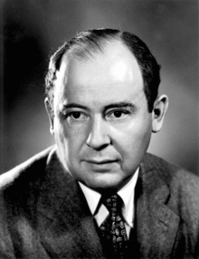
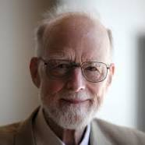
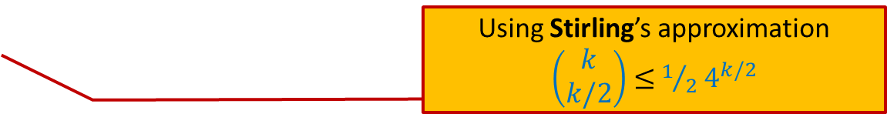
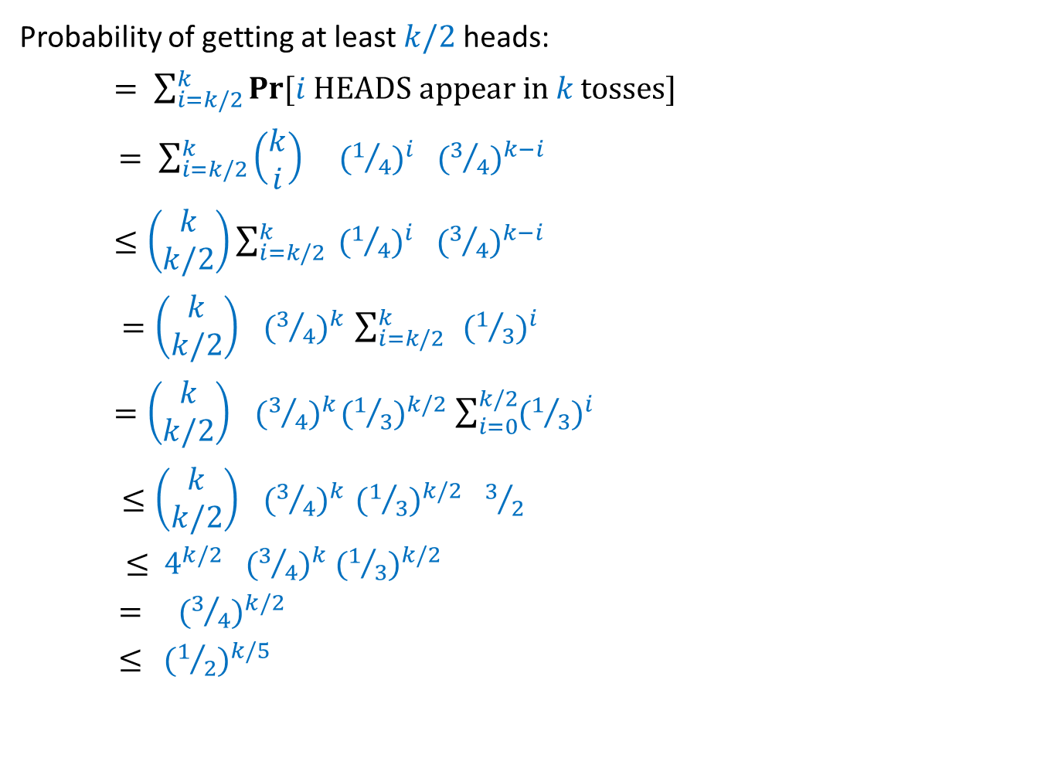


John von Neumann
C. A. R. Hoare
Merge Sort, 1945
Quick Sort, 1960
 | Merge Sort | Quick Sort
Average case comparisons
Worst case comparisons
$$n\log_{2}{n}$$
1.39 $n\log_{2}{n}$
$$n\log_{2}{n}$$
$$n(n−1)$$

Slide 10
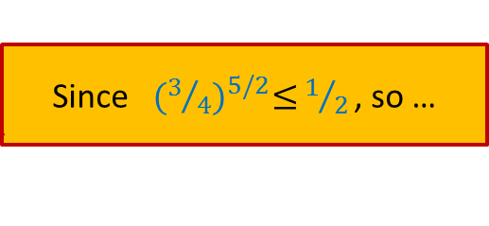

QuickSort($S$) When the input $S$is stored in an array $A$
QuickSort($A$,$l$, $r$)
{ If ($l$ < $r$)
$x$← $A$[$l$];
$i$← Partition($A$,$l$,$r$,x);
QuickSort($A$,$l$, $i−1$);
QuickSort($A$,$i+1$, $r$)
}

Slide 11

A serious problem with QuickSort
QuickSort($A$,$l$, $r$)
{ If ($l$ < $r$)
$x$← $A$[$l$];
$i$← Partition($A$,$l$,$r$,x);
QuickSort($A$,$l$, $i−1$);
QuickSort($A$,$i+1$, $r$)
}
Distribution sensitive:
Time taken depends upon the initial permutation of $A$.
an element selected randomly uniformly from $A$[$l$..$r$];
Can we make QuickSort distribution insensitive ?

Slide 12
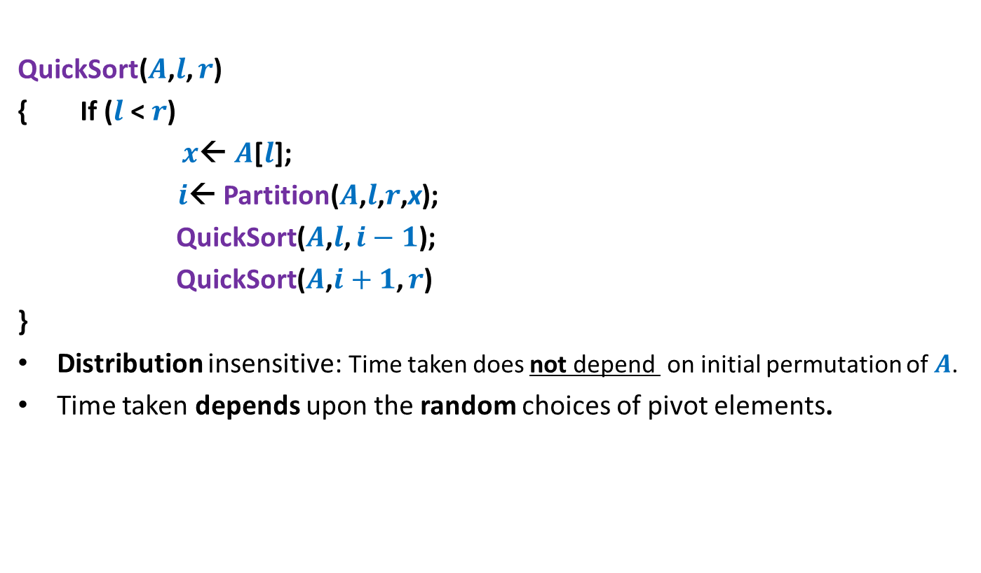

Randomized QuickSort($S$) When the input $S$is stored in an array $A$
QuickSort($A$,$l$, $r$)
{ If ($l$ < $r$)
$x$← $A$[$l$];
$i$← Partition($A$,$l$,$r$,x);
QuickSort($A$,$l$, $i−1$);
QuickSort($A$,$i+1$, $r$)
}
Distribution insensitive: Time taken does not depend on initial permutation of $A$.
Time taken depends upon the random choices of pivot elements.
an element selected randomly uniformly from $A$[$l$..$r$];

Slide 13
Deterministic Algorithm
Input
Output
Algorithm
The output as well as the running time are functions only of the input.
Notes:
The output as well as the running time are functions only of the input.

Slide 14

Deterministic Algorithm
Randomized
Random bits
Input
Output
Algorithm
The output as well as the running time are functions of the input and random bits chosen.
or
Excess running time
on a few occasions
in Output
On a few occasions
Notes:
The output or the running time are functions of the input and random bits chosen .

Slide 15
Still why to study Randomized Algorithms ?
Efficiency
Simplicity
→……….
Deterministic algo.

Slide 16
What makes Randomized Algorithms popular ?
Quick sort
Homework: Keep pondering over this question.
We shall answer this question in 2 weeks from now ☺.

Slide 17
Types of Randomized Algorithms
Randomized Las Vegas Algorithms:
Output is always correct
Running time is a random variable
Example: Randomized Quick Sort
Randomized Monte Carlo Algorithms:
Output may be incorrect with some probability
Running time is deterministic.
Example: Randomized algorithm for approximate median

Slide 18
10 MotivatiNG Examples for randomized Algorithms

Slide 19
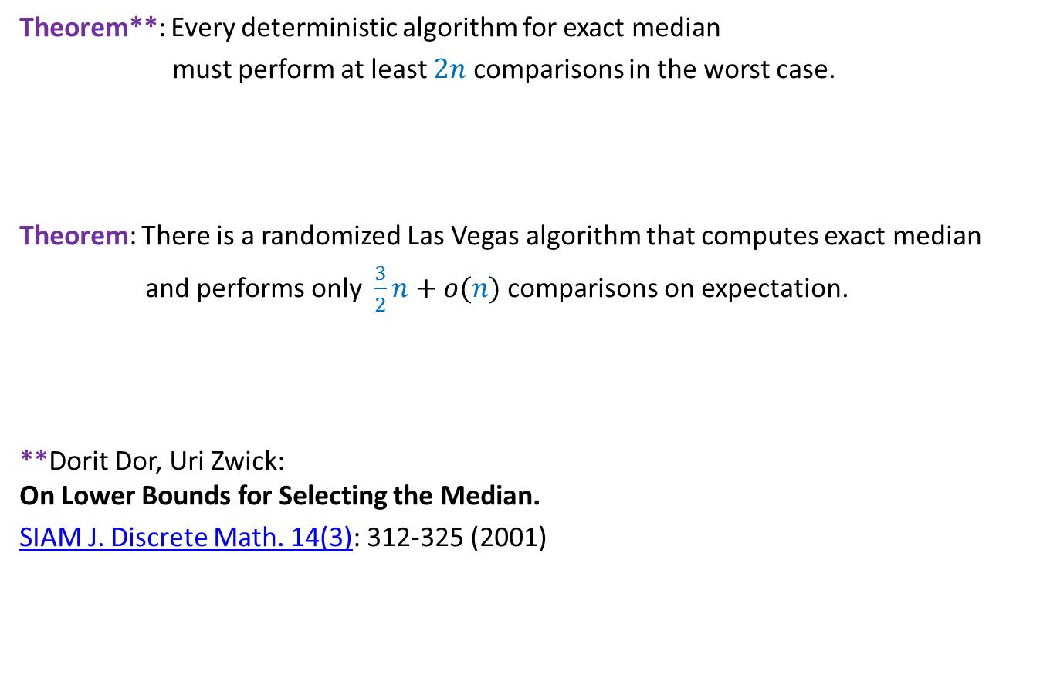
Example 1: Exact Median
Theorem**: Every deterministic algorithm for exact median
must perform at least $2n$ comparisons in the worst case.
Theorem: There is a randomized Las Vegas algorithm that computes exact median
and performs only $\frac{3}{2}n+o(n)$ comparisons on expectation.
**Dorit Dor, Uri Zwick: On Lower Bounds for Selecting the Median.
SIAM J. Discrete Math. 14(3): 312-325 (2001)

Slide 20

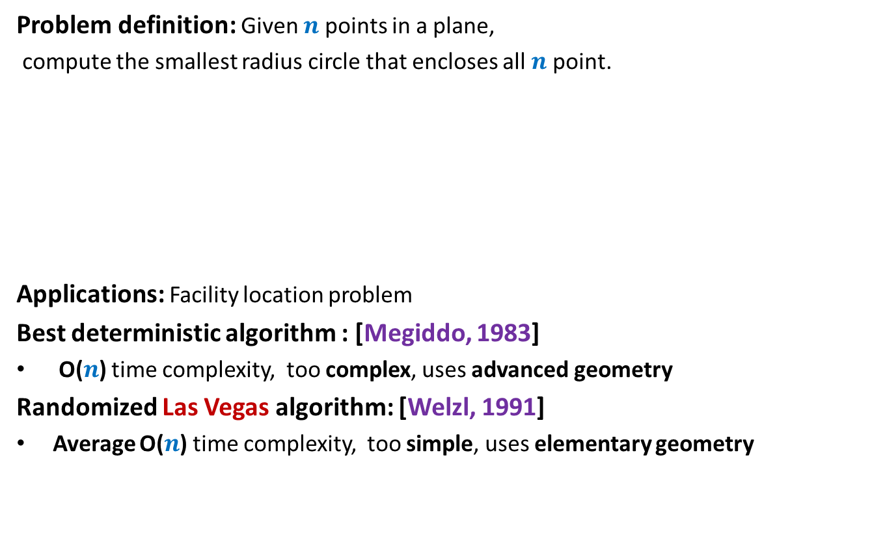
Example 2: Smallest Enclosing circle
Problem definition: Given $n$ points in a plane,
compute the smallest radius circle that encloses all $n$ point.
Applications: Facility location problem
Best deterministic algorithm : [Megiddo, 1983]
O($n$) time complexity, too complex, uses advanced geometry
Randomized Las Vegas algorithm: [Welzl, 1991]
Average O($n$) time complexity, too simple, uses elementary geometry
Simple exercise : O($n^{4}$)

Slide 21
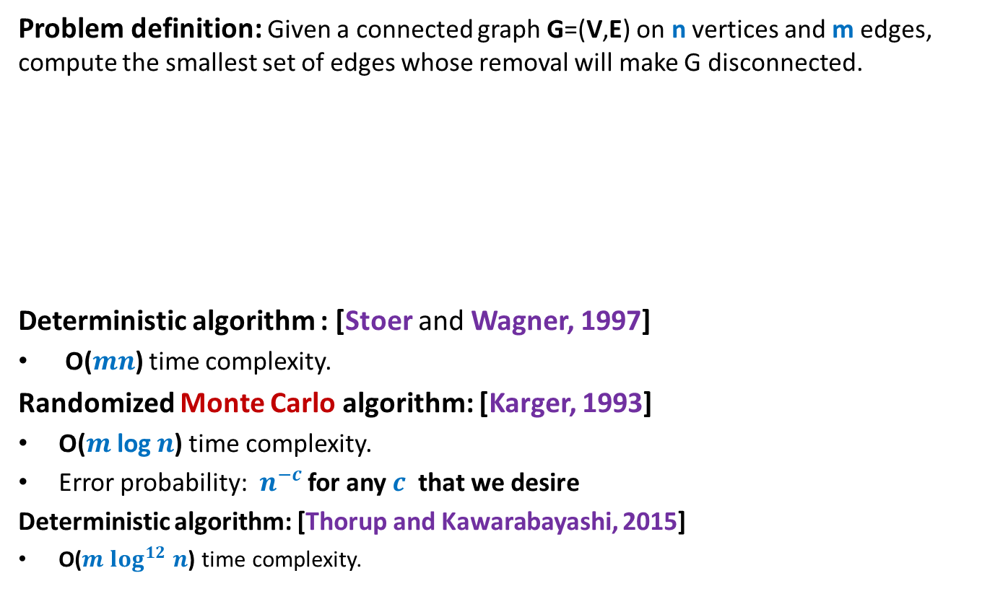
Example 3: minimum Cut
Problem definition: Given a connected graph G=(V,E) on n vertices and m edges, compute the smallest set of edges whose removal will make G disconnected.
Deterministic algorithm : [Stoer and Wagner, 1997]
O($mn$) time complexity.
Randomized Monte Carlo algorithm: [Karger, 1993]
O($m$ log $n$) time complexity.
Error probability: $n^{−c}$ for any $c$ that we desire
Deterministic algorithm: [Thorup and Kawarabayashi, 2015]
O($m log^{12} n$) time complexity.

Slide 22

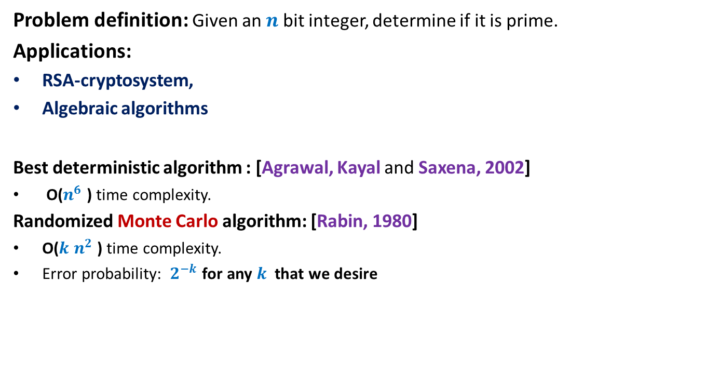
Example 4: Primality Testing
Problem definition: Given an $n$ bit integer, determine if it is prime.
Applications:
RSA-cryptosystem,
Algebraic algorithms
Best deterministic algorithm : [Agrawal, Kayal and Saxena, 2002]
O($n^{6}$ ) time complexity.
Randomized Monte Carlo algorithm: [Rabin, 1980]
O($k$ $n^{2}$ ) time complexity.
Error probability: $2^{−k}$ for any $k$ that we desire
For $k$= $50$, this probability is ${10}^{−15}$

Slide 23
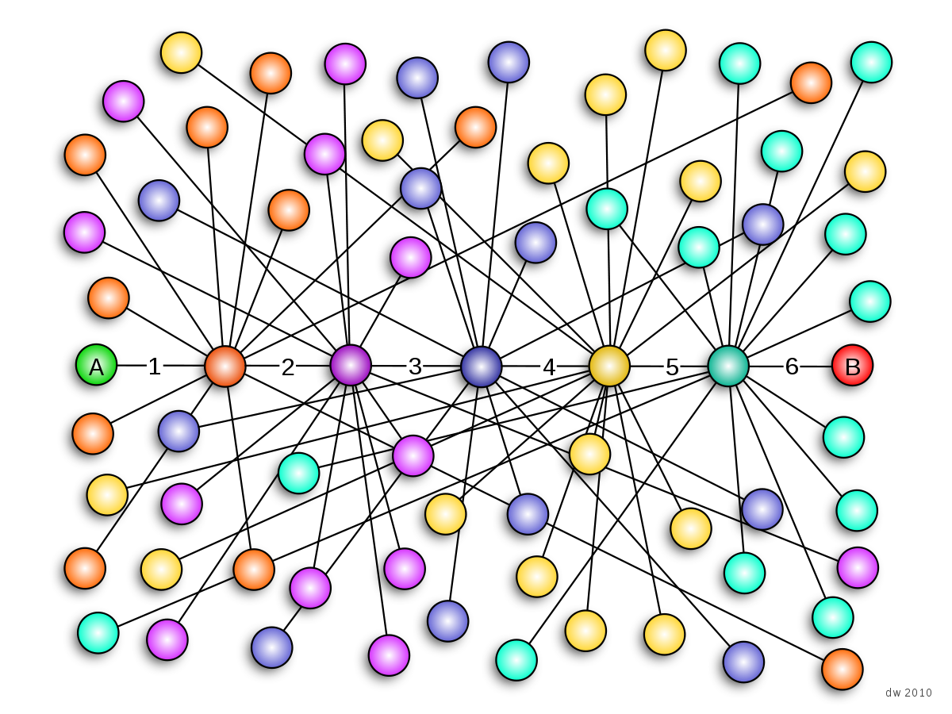
Example 5: Small world phenomenon
Any two persons in the world are connected by a chain of $5$ acquaintances.

Slide 24

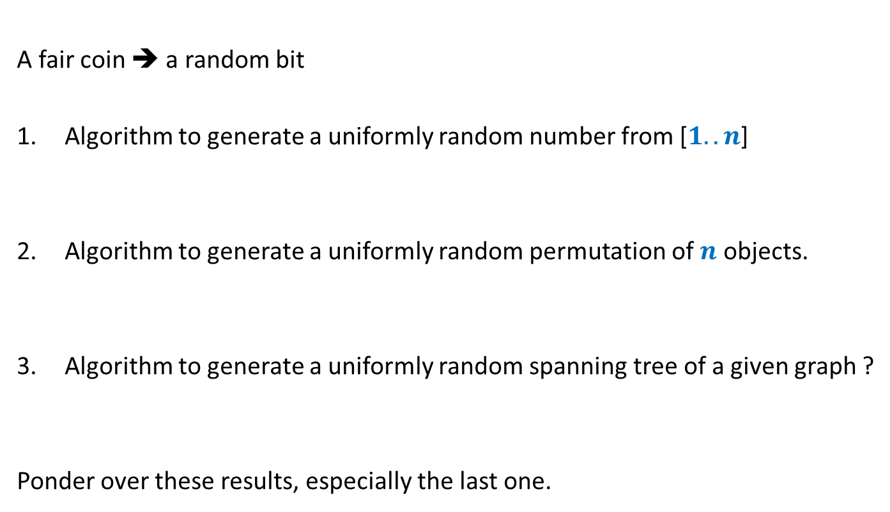

Example 6: Generating a random structure
A fair coin ➔ a random bit
Algorithm to generate a uniformly random number from [$1..n$]
Algorithm to generate a uniformly random permutation of $n$ objects.
Algorithm to generate a uniformly random spanning tree of a given graph ?
Ponder over these results, especially the last one.
$O(log n)$ time and $O(log n)$ random bits
$O(n log n)$ time and $O(n log n)$ random bits
A polynomial time algorithm with polynomial number of random bits.

Slide 25

Example 7: Hashing with worst case guarantee
$U=\left\{1,2,…,m\right\}$ called universe
$S⊆U$ and $s=|S|$
$s≪$ $m$
Examples:
$m={10}^{18}$ , $s={10}^{3}$
Aim
Build a data structure for a given $S$to support the search query :
“Does $i∈$ $S$ ?” for any $i∈U$.

Slide 26
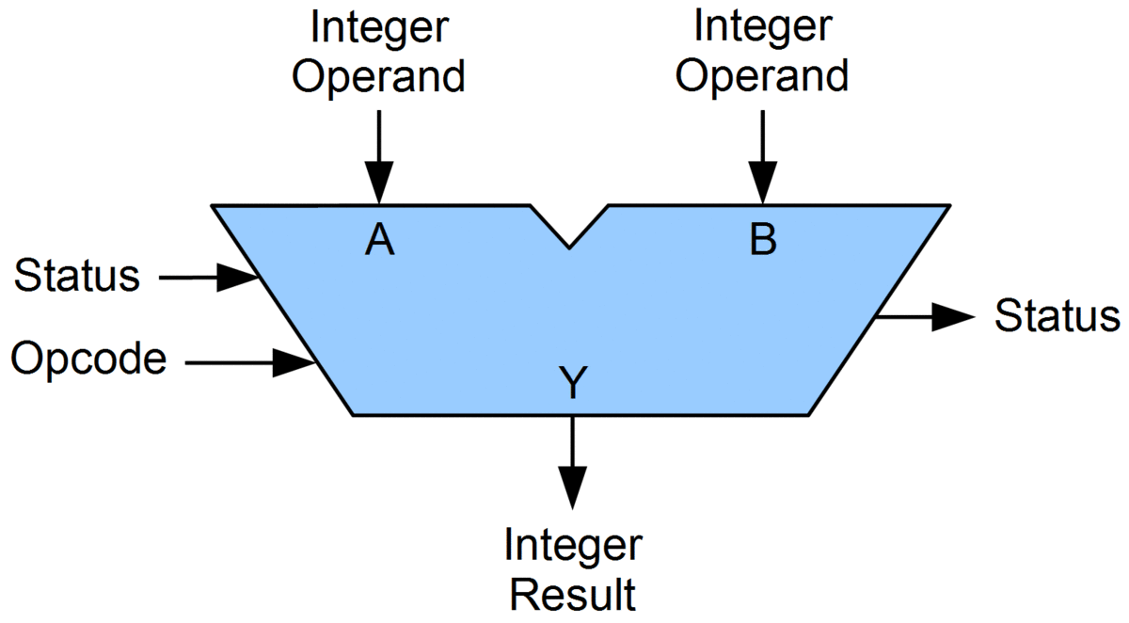

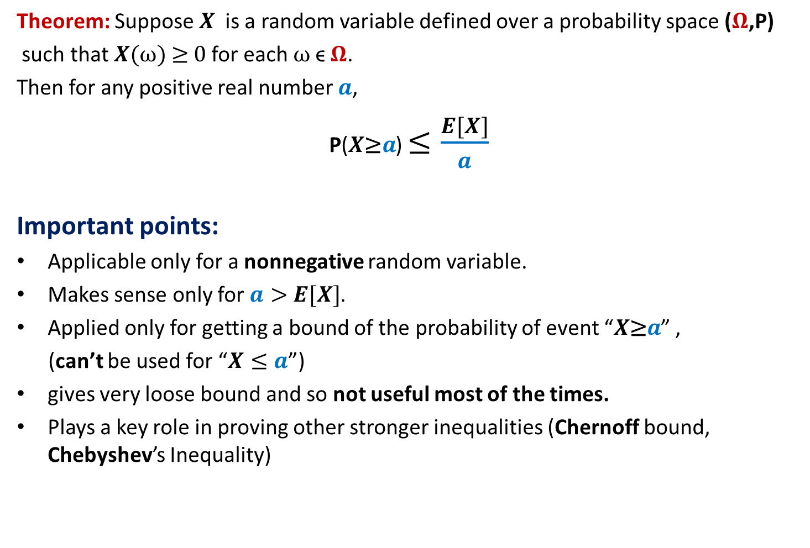

Example 7: Hashing with worst case guarantee
Practical solution with no worst case guarantees
 | Query time | Data structure | Space
Static $S$ | O($log s$) | Array | O($s$)
Dynamic $S$ | O($log s$) | Red-Black trees | O($s$)
Dynamic $S$ | O($1$) | Array
Makes use of comparison
as the basic operation
O($s$)
O($m$)
Impractical
Makes use of fast arithmietic operations on integers
Hashing
ALU
Few cycles for an arithmetic operation

Slide 27
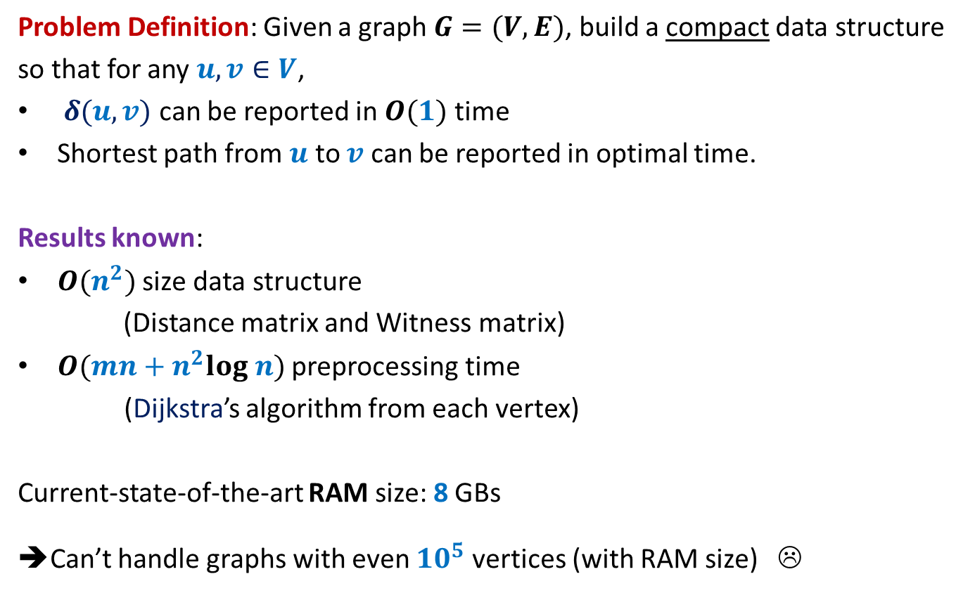
Example 8: All-Pairs Shortest Paths
Problem Definition: Given a graph $G=(V,E)$, build a compact data structure
so that for any $u,v∈V$,
$δ(u,v)$ can be reported in $O(1)$ time
Shortest path from $u$ to $v$ can be reported in optimal time.
Results known:
$O(n^{2})$ size data structure
(Distance matrix and Witness matrix)
$O(mn+n^{2}log n)$ preprocessing time
(Dijkstra’s algorithm from each vertex)
Current-state-of-the-art RAM size: 8 GBs
➔Can’t handle graphs with even ${10}^{5}$ vertices (with RAM size) ☹

Slide 28
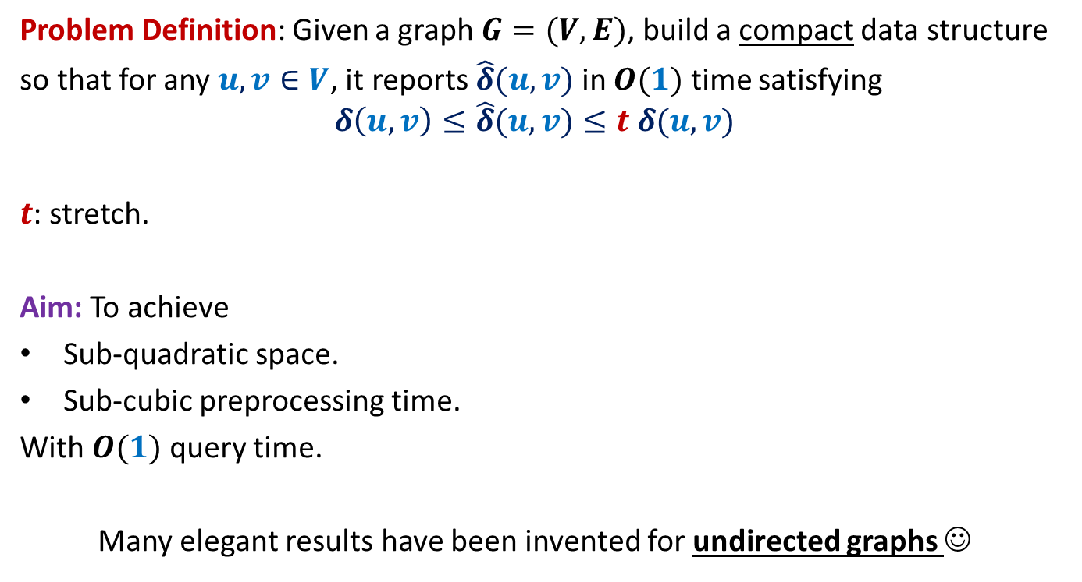
All-Pairs Approximate Shortest Paths
Problem Definition: Given a graph $G=(V,E)$, build a compact data structure
so that for any $u,v∈V$, it reports $\hat{δ}(u,v)$ in $O(1)$ time satisfying
$$δ\left(u,v\right)≤\hat{δ}(u,v)≤t δ(u,v)$$
$t$: stretch.
Aim: To achieve
Sub-quadratic space.
Sub-cubic preprocessing time.
With $O(1)$ query time.
Many elegant results have been invented for undirected graphs ☺

Slide 29





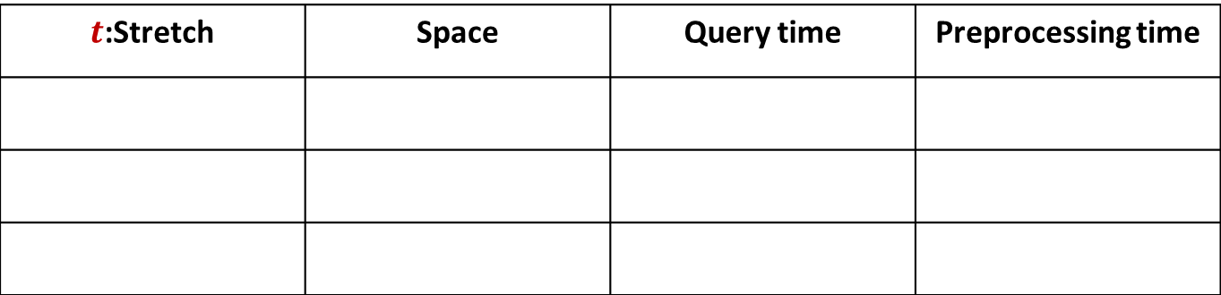







A truly magical result
Approximate Distance Oracles
$t$:Stretch | Space | Query time | Preprocessing time
$$3$$
$$O(n^{1+\frac{1}{2}})$$
$$O(1)$$
$$O({mn}^{\frac{1}{2}})$$
$$5$$
$$O(n^{1+\frac{1}{3}})$$
$$O(1)$$
$$O({mn}^{\frac{1}{3}})$$
$$2k−1$$
$$O(n^{1+\frac{1}{k}})$$
$$O(k)$$
$$O({k mn}^{\frac{1}{k}})$$
Mikkel Thorup and Uri Zwick:
Approximate Distance Oracles for graphs,
Journal of ACM (4), 2005

Slide 30
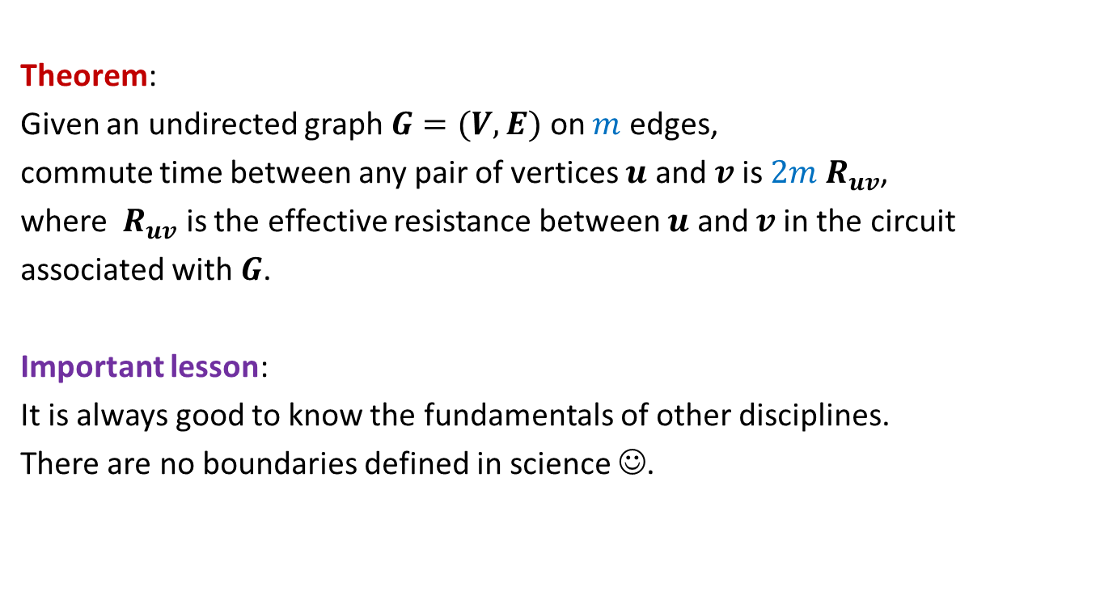
Example 9: Random walk and Electric networks
Theorem:
Given an undirected graph $G=(V,E)$ on $m$ edges,
commute time between any pair of vertices $u$ and $v$is $2m{ R}_{uv}$,
where ${ R}_{uv}$ is the effective resistance between $u$ and $v$in the circuit
associated with $G$.
Important lesson:
It is always good to know the fundamentals of other disciplines.
There are no boundaries defined in science ☺.

Slide 31

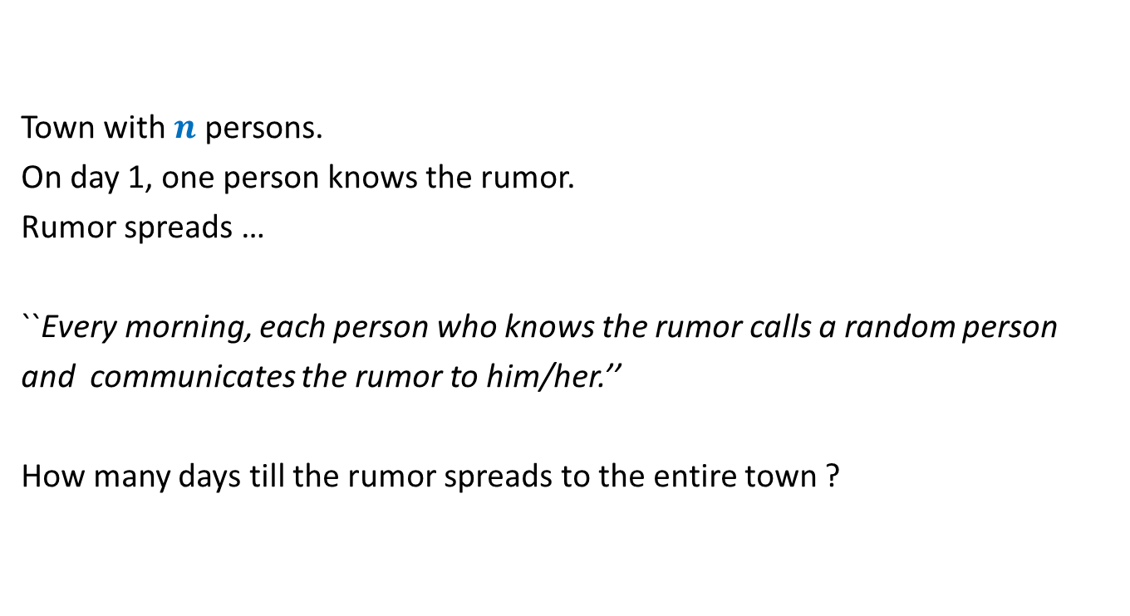
Example 10: Rumor Spreading
Town with $n$ persons.
On day 1, one person knows the rumor.
Rumor spreads …
``Every morning, each person who knows the rumor calls a random person
and communicates the rumor to him/her.’’
How many days till the rumor spreads to the entire town ?
$O(log n)$ days with high probability

Slide 32
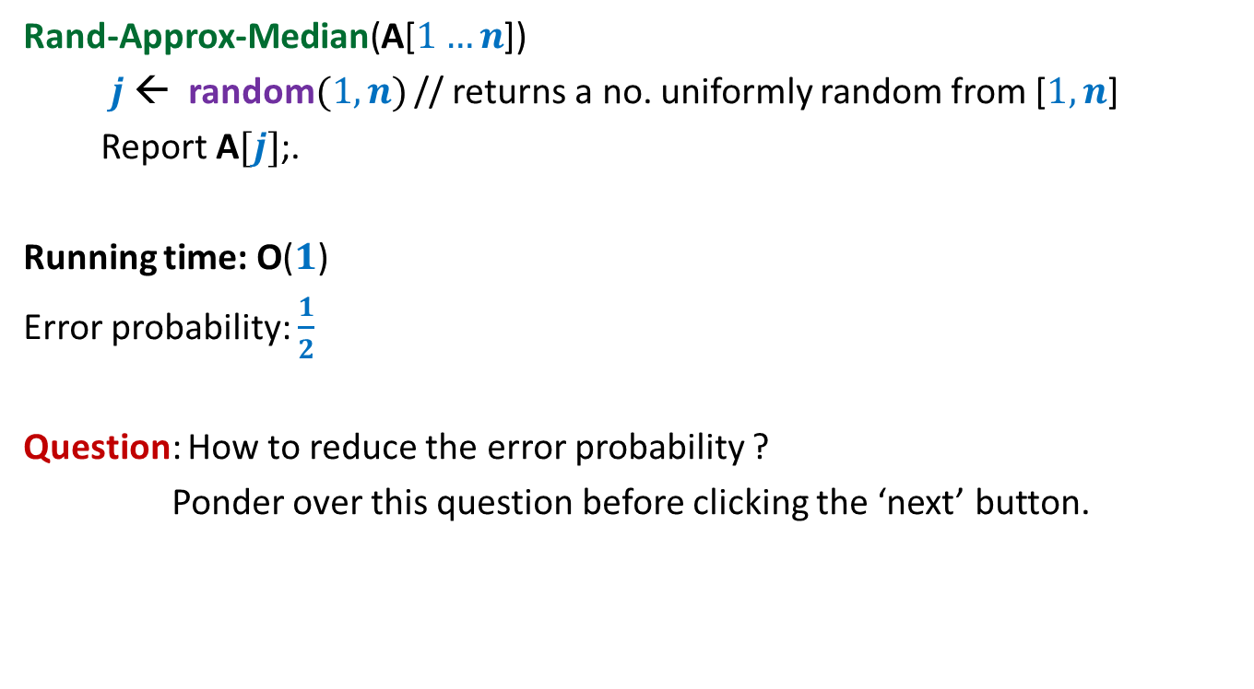
½ - Approximate median A Randomized Algorithm
Rand-Approx-Median(A[$1…n$])
$j$ ← random$(1,n)$ // returns a no. uniformly random from [$1,n$]
Report A$[j]$;.
Running time: O($1$)
Error probability: $\frac{1}{2}$
Question: How to reduce the error probability ?
Ponder over this question before clicking the ‘next’ button.
Select multiple elements and …
return their median.

Slide 33
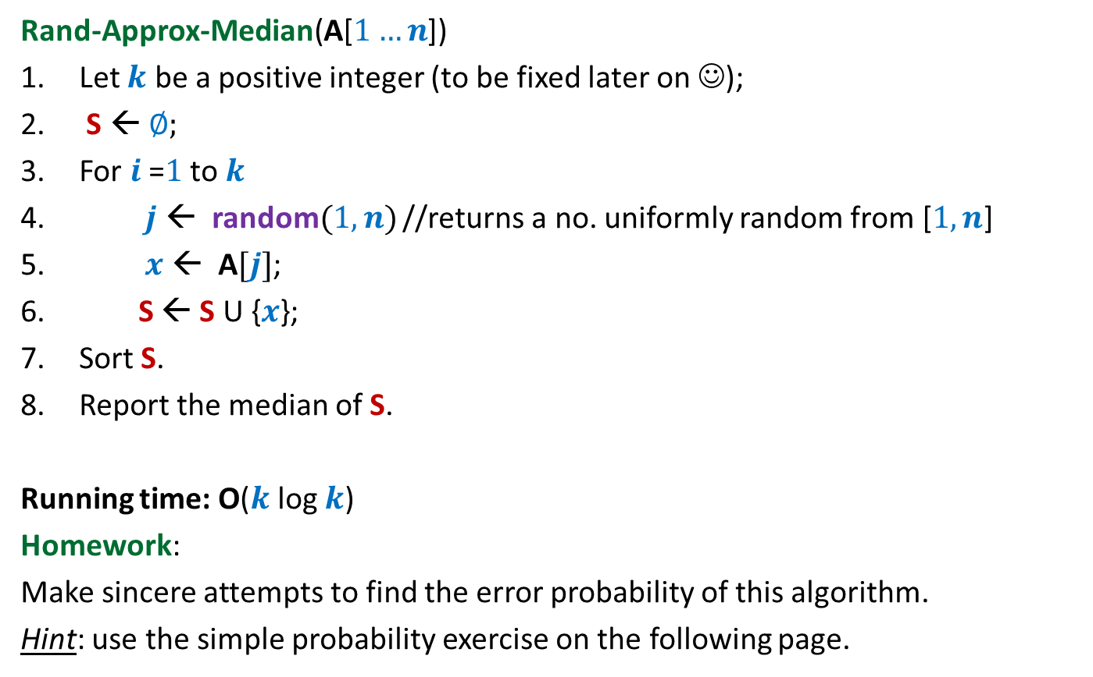
½ - Approximate median A Randomized Algorithm
Rand-Approx-Median(A[$1…n$])
Let $k$ be a positive integer (to be fixed later on ☺);
S ← ∅;
For $i$=$1$ to $k$
$j$ ← random$(1,n)$ //returns a no. uniformly random from [$1,n$]
$x$ ← A$[j]$;
S ← S U {$x$};
Sort S.
Report the median of S.
Running time: O($k$ log $k$)
Homework:
Make sincere attempts to find the error probability of this algorithm.
Hint: use the simple probability exercise on the following page.

Slide 34


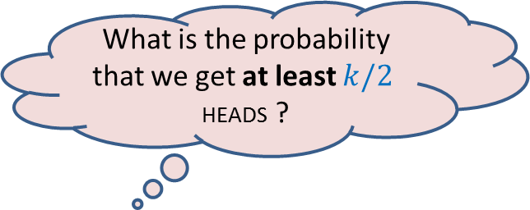
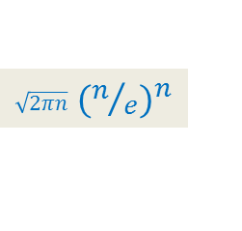
A simple probability exercise
P[HEADS] = ¼
P[TAILS] = ¾
The coin is tossed $k$ times.
[Stirling’s approximation for Factorial: $n! ≈$ ? ]
What is the probability that we get at least $k/2$ HEADS ?
$\sqrt{2πn}$ ${(n/e)}^{n}$

Slide 35
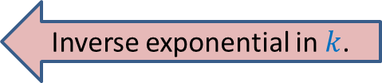
Probability of getting “at least $k/2$HEADS in $k$tosses”
Probability of getting at least $k/2$heads:
$= \sum_{i=k/2}^{k}{Pr\text{[}i \text{HEADS} \text{appear} \text{in} k \text{tosses}\text{]}}$
$= \sum_{i=k/2}^{k}{\left(\begin{matrix}k \\ i\end{matrix}\right) }{ (1/4)}^{i}{ (3/4)}^{k−i}$
$≤\left(\begin{matrix}k \\ k/2\end{matrix}\right)\sum_{i=k/2}^{k}{ {(1/4)}^{i}{ (3/4)}^{k−i}}$
$=\left(\begin{matrix}k \\ k/2\end{matrix}\right){ (3/4)}^{k} \sum_{i=k/2}^{k}{ }{(1/3)}^{i}$
$=\left(\begin{matrix}k \\ k/2\end{matrix}\right){ (3/4)}^{k}{(1/3)}^{k/2} \sum_{i=0}^{k/2}{{(1/3)}^{i}}$
$≤\left(\begin{matrix}k \\ k/2\end{matrix}\right){ (3/4)}^{k} {(1/3)}^{k/2}{ 3}/2$
$≤$ $4^{k/2}{ (3/4)}^{k} {(1/3)}^{k/2}$
$=$ ${ (3/4)}^{k/2}$
$≤{ (1/2)}^{k/5}$
Using Stirling’s approximation
$\left(\begin{matrix}k \\ k/2\end{matrix}\right)$ $≤$ $1/2$ $4^{k/2}$
Inverse exponential in $k$.
Since${ (3/4)}^{5/2}≤$ $1/{2 }$, so …

Slide 36
Prerequisites for the course
Elementary knowledge of probability
Formal analysis
Formal proof of correctness
Basic algorithm paradigms
Basic knowledge of Data structures and algorithms
Ability to work very hard
Commitment to attend all classes
unless you have any genuine personal/medical problem

Slide 37
Course website
moodle.cse.iitk.ac.in
Use guest login.

